Slide 1

Remaining Useful Lifetime Prediction of Turbofan Jet Engine
By :
Hazmil HASBULLAH
Batch 012-Paris
December 16th 2020
#predictive_maintenance
#RUL
#prognostics_health_management
#machine_learning
Notes:
Durée/cycle de vie restant

Slide 2
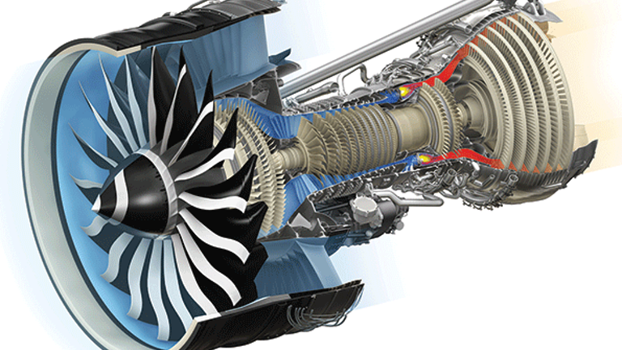
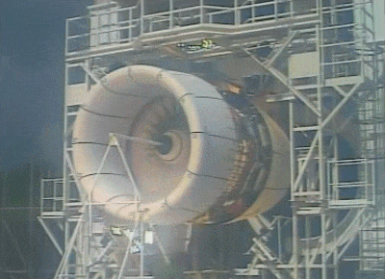
Context of study
NASA’s Turbofan Engine Degradation Simulation
Predict remaining cycle left based on historical data
Sensors measurements on similar engine
Identifify degradation pattern
Maintenance prediction
Make decision
First
observation
Degradation
End of life
too early
too late
Why ?
Cost effective ⇗
Profitability ⇘
Less labor-intensive
Notes:
Moteur d’avion, turboréacteur
Donnée historiques – Prédire
Quelle sont les inputs ?
Observer les patterns pour aider à la prise de décision au bon moment
Pour optimiser le cout, optimiser les mains d’oeuvre

Slide 3
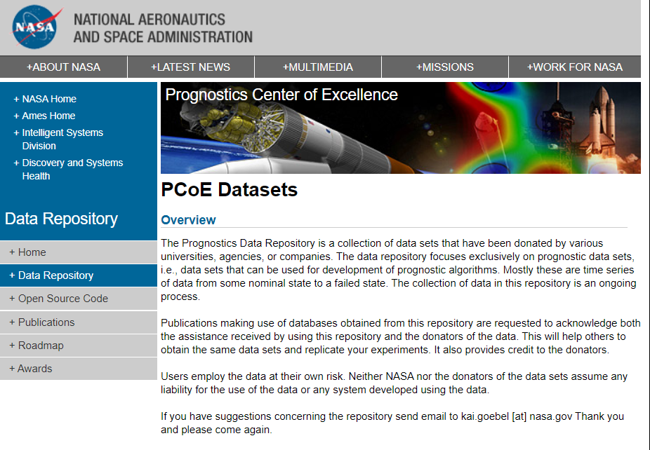
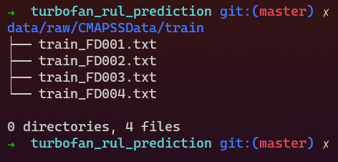
Datasets
Public source :
Prognostic Health Management
Data state :
Clean, no missing values, no duplicates
≈ conditions
≠ Operating conditions :
Altitude, Mach number, Throttle resolver angle, …
Data type :
Numerical (continous and discreet)
Last update : May 2020
Notes:
Source : NASA Prognostic Health Management, regulièrement updated, donnée simulations
Qualité de données : Pas de valeur manquante, pas de doublage, ( à part 2 cols à la fin qui est totalement vide)
Conditions d’opérations different selon datasets FD001, 002, 003, 004
Mach number : ration of object speed-speed of sound
Important de les traiter à part en premier lieu.
Type de données : Numérique : continu & discret, time series-ish

Slide 4
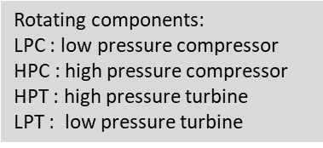


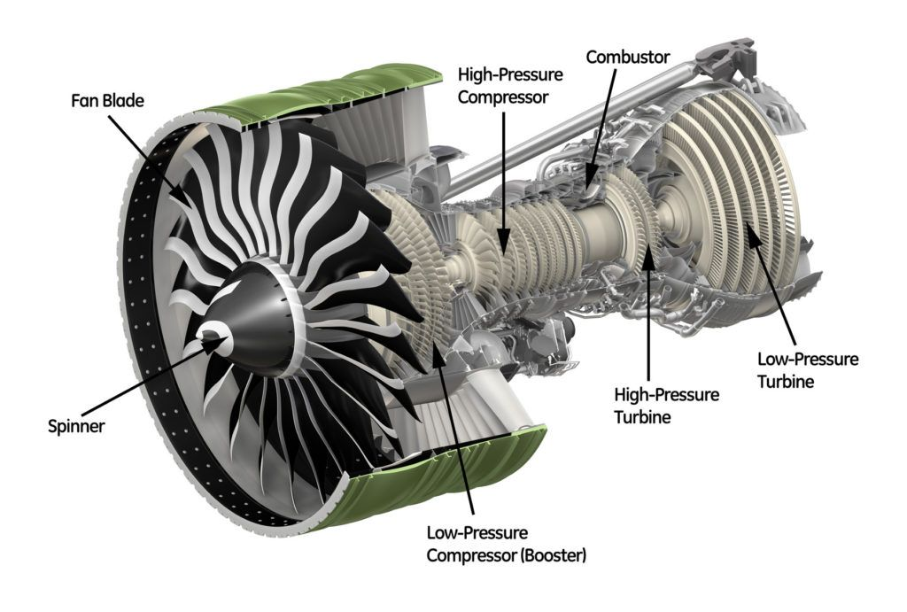
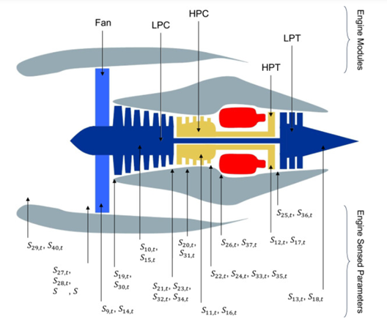
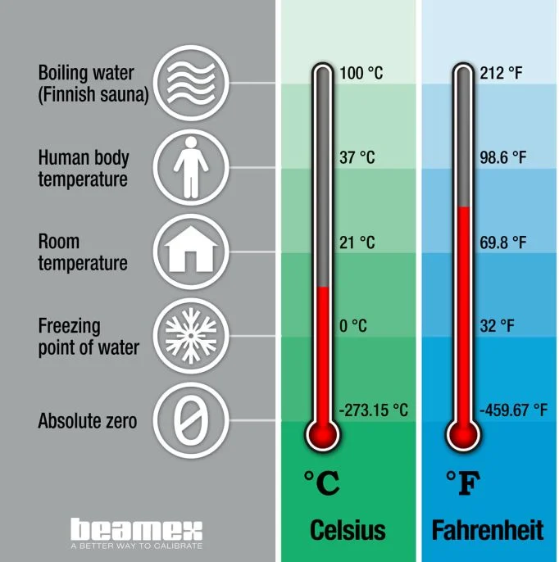
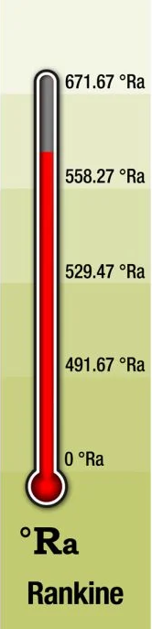
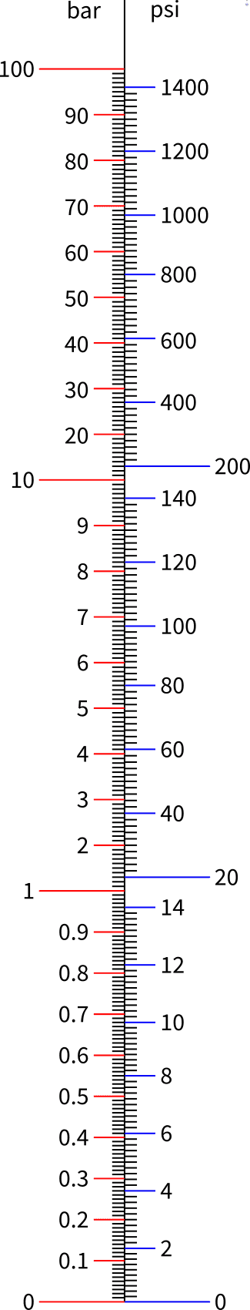

Sensor measurement & units
Temperature, °R
Pressure, psi
Who measures what ?
burner
burner
Speed, rpm
Notes:
2D dissection of system de moteur
Compressor C
Turbine T
Low-high-high-low
Placement des capteurs
Qui mesures quoi ?
Temperature
Pression
Vitesse

Slide 5
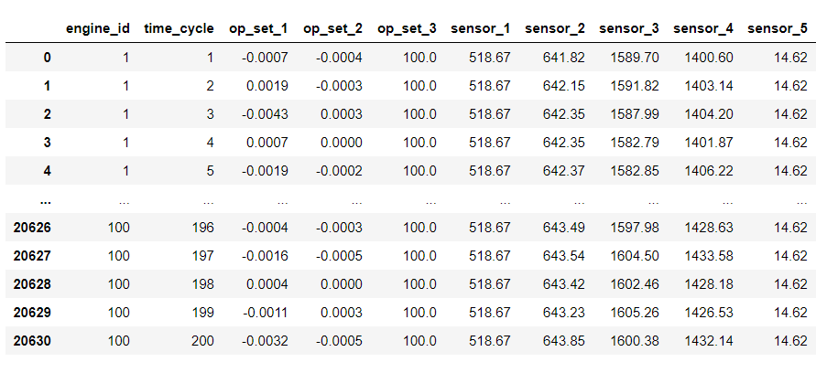
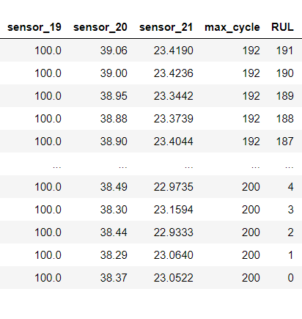
Dataset structure
compute
unique engine
# of flight
Operation settings
Features
(Sensor’s signal)
Last cycle
Target
*
Hypothesis :
Last cycle = end of life (aggregated by engine_id)
RUL : interaction between number of flight & end of life
*Remaining useful lifetime
Notes:
Formuler hypothèses : last cycle d’enregistrement est considéré comme la cycle de défaillance
Cycle de vie restant est la différence entre col time_cycle & max_cycle

Slide 6
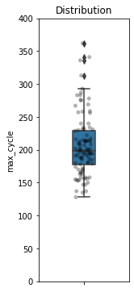
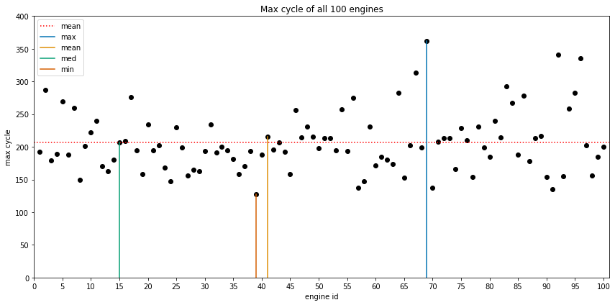
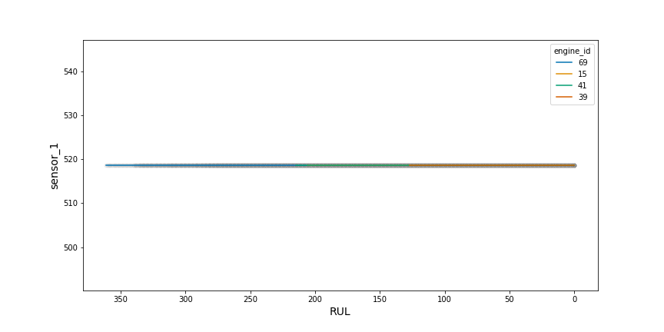
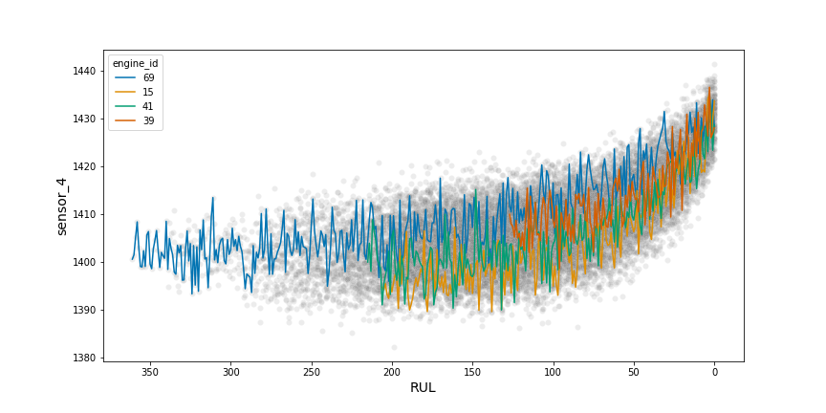
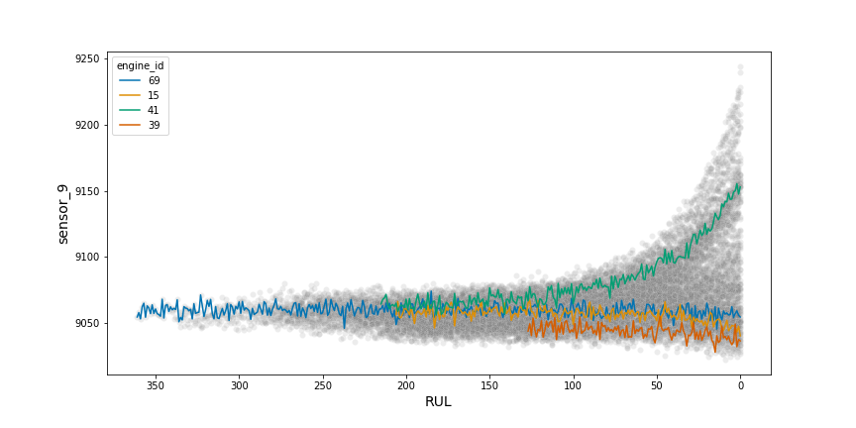
Exploratory Data Analysis
Feature Engineering
Feature Selection
Model Building
Model Evaluation
Model Deployment
Observe distribution
General behaviour
Identify pattern
Detect anomaly
Last cycle
Constant /
Quasi-constant signal
Increase
Diverge
Sensors_1, 5, 6, 10, 16, 18, 19
Sensors_2, 3, 4, 8, 12, 13, 15
Sensors_9, 14
Notes:
EDA : Why ?
Observer la distribution de mesures
Peut-t-on généraliser les comportement de signals au cours de temps
Identifier pattern at certain plage de temps
Des tous les engines, je décide de choisir 4 engine (69, 15, 41, 39) à présenter
X-axis inversé pour avoir le notion de temps varie de gauche à droite
Augmenter / diminuer
Diverge ou anomaly

Slide 7
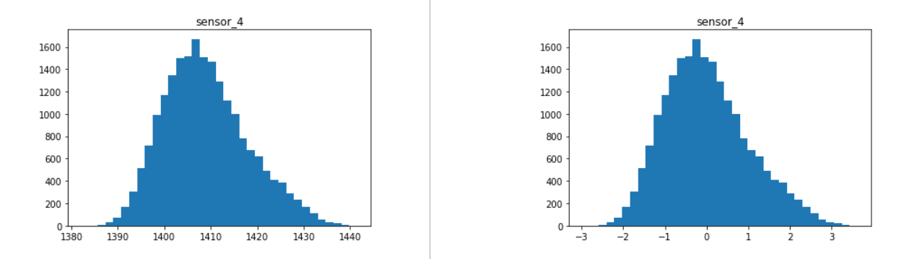
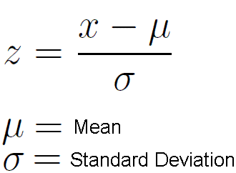
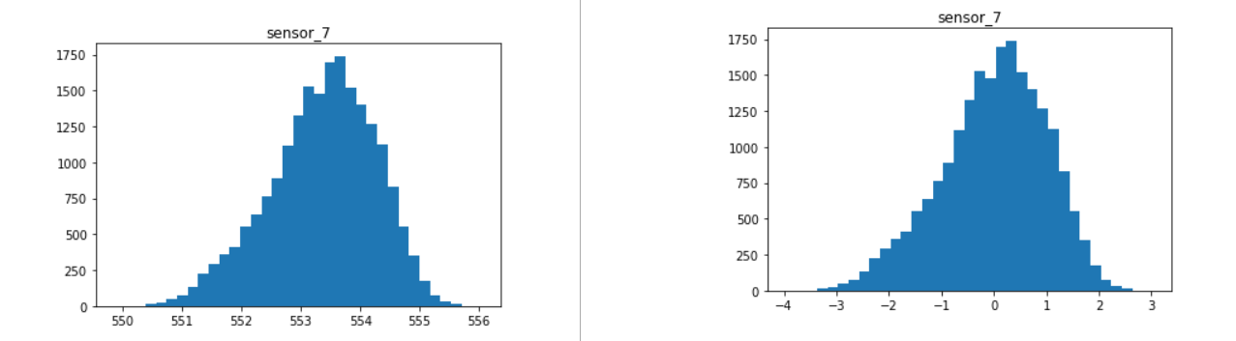
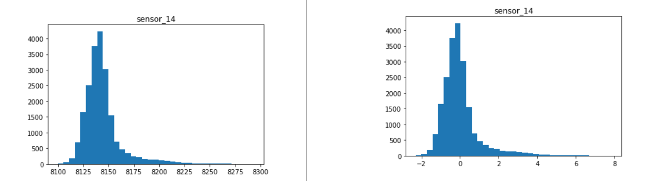
Exploratory Data Analysis
Feature Engineering
Feature Selection
Model Building
Model Evaluation
Model Deployment
Absolute unit
Scaled (unitless)
Features interactions and aggregation
Introduce new indicators
final cycle
RUL
Health index
Features scaling
°R
psi
rpm
magnitude influence
Notes:
HI to investigate more

Slide 8
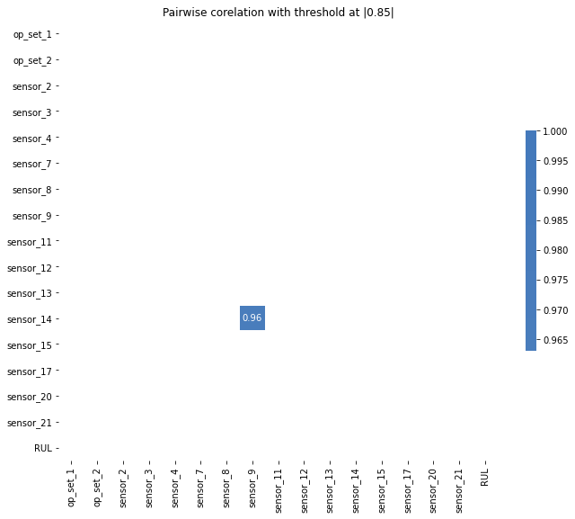
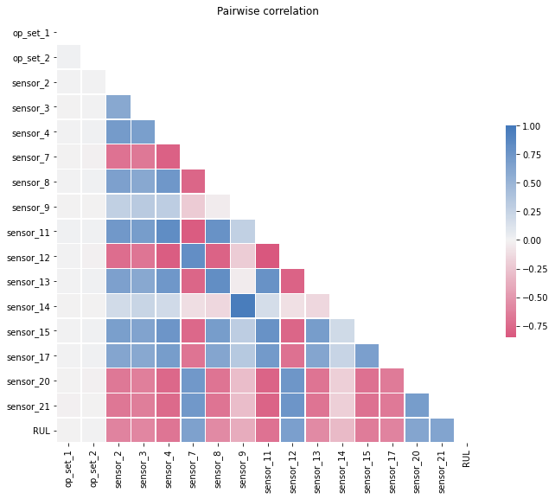
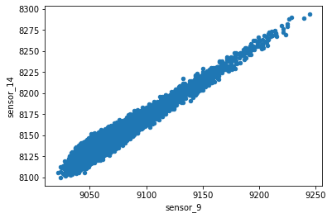
Exploratory Data Analysis
Feature Engineering
Feature Selection
Model Building
Model Evaluation
Model Deployment
Remove :
Constant/quasi-constant features
Noise (operation settings)
Chose :
sensor_14 or sensor_9
Notes:
Grace à EDA,
On peut enlever les signals qui n’influent pas la target & les signals d’autre capteur
Les bruits
Corellation pearson, fixe la seuil à 85% et j’ai trouvé le sensor_14 et sensor_9 sont fortement correlé
Vitesse de rotation de core, physical & corrected

Slide 9
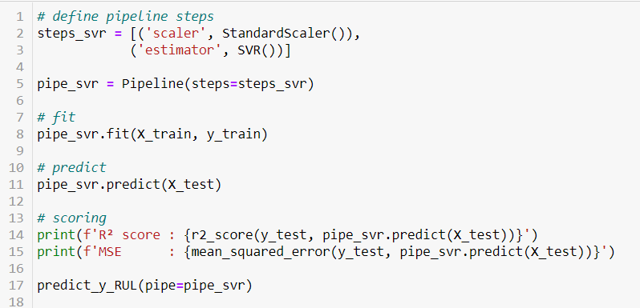
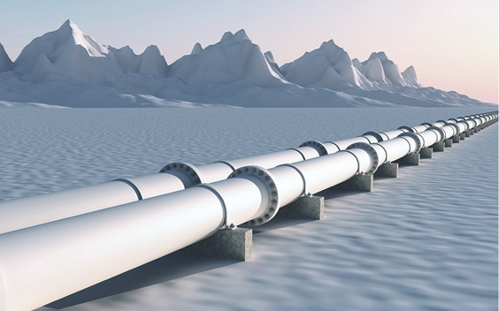
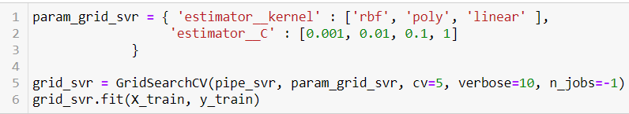
Exploratory Data Analysis
Feature Engineering
Feature Selection
Model Building
Model Evaluation
Model Deployment
Regression learning
Define pipeline
Use Linear Regression model as benchmark
Introduce non linearity (polynomial)
Testing different regressor model
Hyperparameters grid search

Slide 10
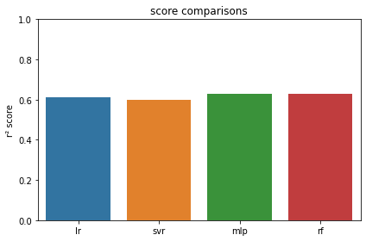
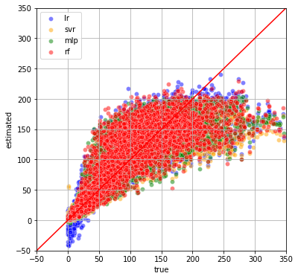
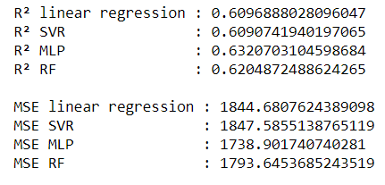
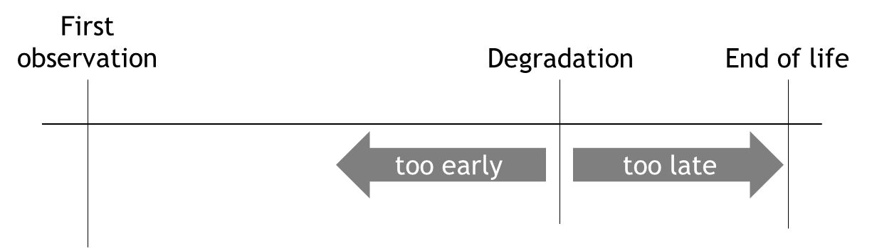
Exploratory Data Analysis
Feature Engineering
Feature Selection
Model Building
Model Evaluation
Model Deployment

Slide 11

Exploratory Data Analysis
Feature Engineering
Feature Selection
Model Building
Model Evaluation
Model Deployment
Link to web UI

Slide 12
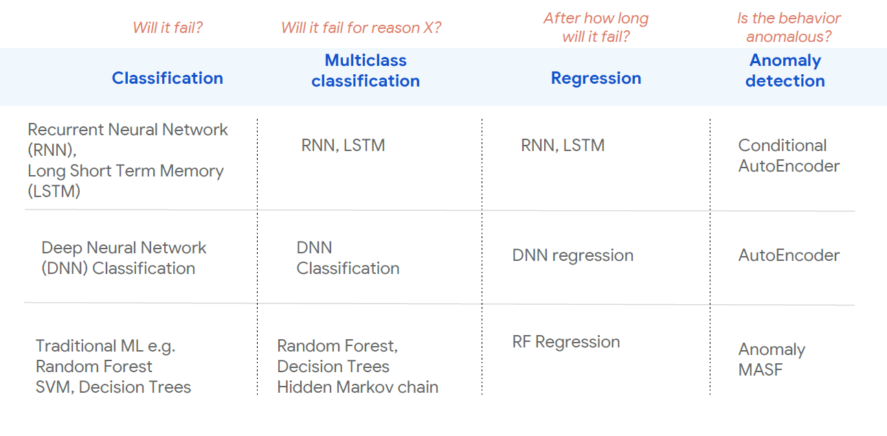
Conclusion & Next Steps
Score ~ 60 % to improve
Introduce ML complexity
Decision for maintenance intervention TBD
Broaden the scope of predictive maintenance

Slide 13
Thanks for listening

Slide 14

Speacial thanks to
Gaëlle Nicolas Youssef
Maël Arthur
Léo
Mathis
Yannis
All batch-012-paris mates

Slide 15
Annexes

Slide 16
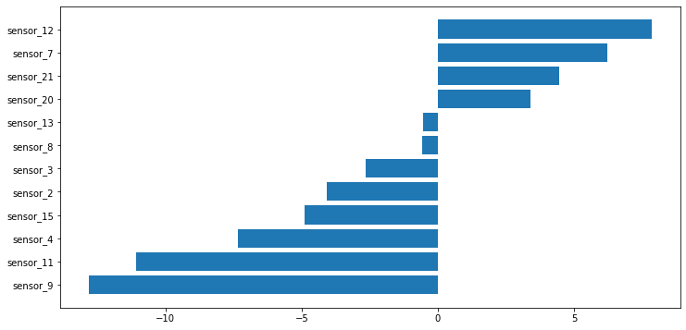
Annexe 1

Slide 17
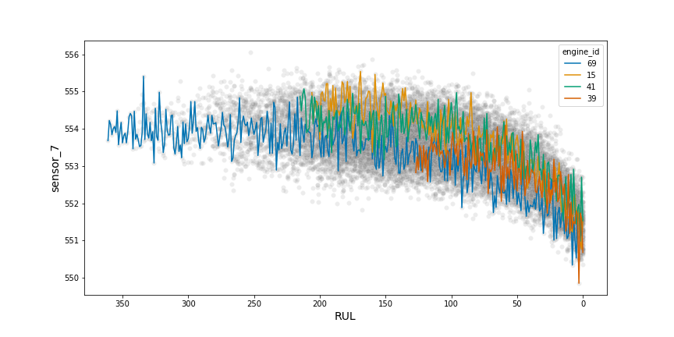
Exploratory Data Analysis
Feature Engineering
Feature Selection
Model Building
Model Evaluation
Model Deployment
Constant / Quasi-constant signal
Increase
Anomaly
Sensors_1, 5, 6, 10, 16, 18, 19
Sensors_2, 3, 4, 8, 12, 13, 15
Sensors_9, 14
Decrease
Sensors_7, 11, 20, 21

